Slide 1
Logistics Optimization for Delivery Routes - Flipkart
A SQL-Driven Analysis of Delivery Performance
Presented by: Preetham Sharvin Danthi
For: Internshala Trainings

Slide 2

Project Overview & Objective
1.Flipkart’s logistics arm, Ekart, delivers millions of orders daily across metros and smaller cities.
2.With rising order volumes, it’s facing challenges like delivery delays, route inefficiencies, and traffic disruptions
3.These issues are leading to higher costs and lower customer satisfaction.
4.The goal is to analyze logistics data from relational databases to uncover patterns that can help improve delivery efficiency and reduce delays.

Slide 3
Project Objective: The Solution
1.We’re building a SQL based analytics system to study and improve delivery performance.
2.The idea is to use SQL queries to find out what’s actually causing delivery delays and how routes can be made more efficient.
3.We’ll also look at ways to improve shipment handling and delivery agent performance.
4.In the end, the goal is to come up with practical, data backed recommendations to make deliveries faster and smoother.

Slide 4
Task 1: Data Cleaning & Preparation
Task 1.1 Identify and delete duplicate Order ID records
01
1.We first checked the dataset for any duplicate Order IDs, since duplicates could affect the accuracy of our analysis.
02
2.Using a SQL query, we identified and kept only one unique record for each order to ensure clean and reliable data.
03
Result : All duplicate orders were successfully removed.
04

Slide 5
INSERT INTO Orders_Clean
WITH RankedOrders AS (
SELECT
*,
ROW_NUMBER() OVER (
PARTITION BY Order_ID
ORDER BY Order_Date
) AS row_num
FROM
Orders
)
SELECT
Order_ID, Warehouse_ID, Route_ID, Agent_ID,
Order_Date, Expected_Delivery_Date,
Actual_Delivery_Date, Status, Order_Value
FROM
RankedOrders
WHERE
row_num = 1;
Result: Identified and deleted 300+ duplicate records

Slide 6
Task 1.2 : Replace null Traffic_Delay_Min with the average delay for that route.
1.The Routes table had some missing values for traffic delay, which could affect the analysis.
2.To fix this, we replaced the empty cells with the average traffic delay calculated for each specific route, ensuring the data stayed consistent and accurate.
Result : The Query return an empty table, Meaning there were no remaning NULL_VALUES For Traffic_Delay
This confirms that all missing data has been successfully filled in, ensuring our route analysis is now clean and accurate.

Slide 7
SET SQL_SAFE_UPDATES = 0;
UPDATE Routes r
JOIN (
SELECT
Route_ID,
AVG(Traffic_Delay_Min) AS avg_for_route
FROM Routes
WHERE Traffic_Delay_Min IS NOT NULL
GROUP BY Route_ID
) AS route_avg ON r.Route_ID = route_avg.Route_ID
SET r.Traffic_Delay_Min = route_avg.avg_for_route
WHERE r.Traffic_Delay_Min IS NULL;
SELECT * FROM Routes
WHERE Traffic_Delay_Min IS NULL;

Slide 8
Task 1.3 : Convert all date columns into YYYY-MM-DD format using SQL functions.
1.The date columns in the Orders and Shipment Tracking tables were originally stored as plain text (VARCHAR).
2.To make calculations like delivery delays possible, we converted them into proper DATE and DATETIME formats using the STR_TO_DATE() function and ALTER TABLE command.
Result : All the date and time columns have now been converted into a standardized YYYY-MM-DD format.

Slide 9
UPDATE Orders
SET Order_Date = STR_TO_DATE(Order_Date, '%Y-%m-%d'),
Actual_Delivery_Date = STR_TO_DATE(Actual_Delivery_Date, '%Y-%m-%d');
ALTER TABLE Orders
MODIFY COLUMN Order_Date DATE,
MODIFY COLUMN Actual_Delivery_Date DATE;

Slide 10
Task 1.4 : Ensure that no Actual_Delivery_Date is before Order_Date (flag such records).
1.After fixing the dates, we did a quick check to make sure no order showed a delivery date that came before the order date

Slide 11
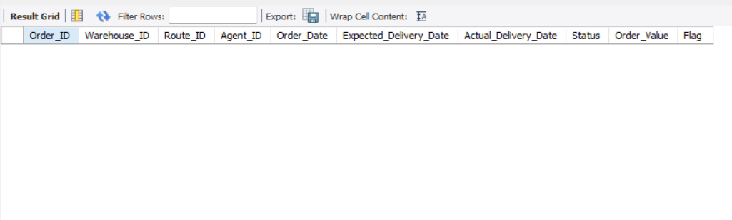
SELECT
*,
'Invalid Date Flag' AS Flag
FROM
Orders
WHERE
Actual_Delivery_Date < Order_Date;
Result: 0 rows returned.

Slide 12
Task 2: Delivery Delay Analysis
Task 2.1 Calculate delivery delay (in days) for each order
1.The first step in our analysis was to calculate how long each order was delayed.
2.We did this using the DATEDIFF() function, which finds the number of days between the Order_Date and the Actual_Delivery_Date.

Slide 13
SELECT
Order_ID,
Route_ID,
Actual_Delivery_Date,
Order_Date,
DATEDIFF(Actual_Delivery_Date, Order_Date) AS delivery_delay_days
FROM
Orders;

Slide 14
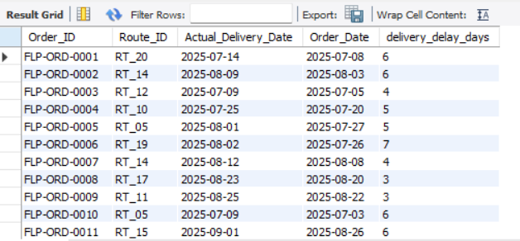
Result: The query added a new column called delivery_delay_days, which shows how many days each order was delayed.

Slide 15
Task 2.2 : Find Top 10 delayed routes based on average delay days.
1. Calculated the average delivery delay for each route to find the worst performers.
SELECT
Route_ID,
AVG(DATEDIFF(Actual_Delivery_Date, Order_Date)) AS avg_delay_days
FROM Orders
GROUP BY Route_ID
ORDER BY avg_delay_days DESC
LIMIT 10;

Slide 16
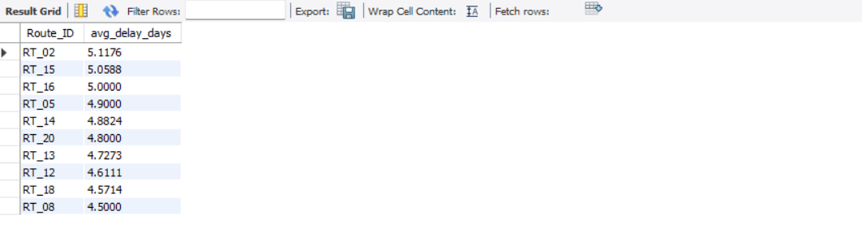
Result : This query pinpoints the 10 routes with the highest average delays.

Slide 17
Task 2.3 : Use window functions to rank all orders by delay within each warehouse.
1.To understand how each warehouse was performing, I used the RANK() window function.
2.This function ranks all orders based on their delivery delay, and with the PARTITION BY clause, the ranking resets for each warehouse, giving a clear view of performance within every location.
SELECT
Order_ID,
Warehouse_ID,
DATEDIFF(Actual_Delivery_Date, Order_Date) AS delivery_delay_days,
RANK() OVER (
PARTITION BY Warehouse_ID
ORDER BY DATEDIFF(Actual_Delivery_Date, Order_Date) DESC
) AS delay_rank
FROM
Orders;

Slide 18
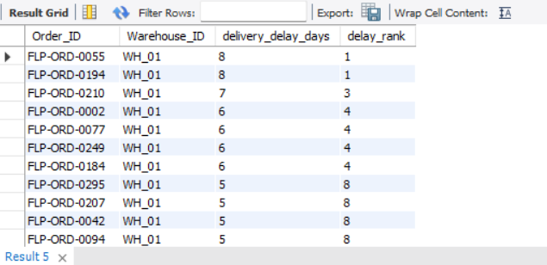
Result : The new delay_rank column (as shown in the screenshot) turned out to be really useful.
1. It lets a warehouse manager say at WH_01 quickly spot their worst delayed order (rank 1) and look into what went wrong, without getting mixed up with delays from other warehouses.

Slide 19
Task 3: Route Optimization Insights
Task 3.1 : For each route, calculate:
Average delivery time (in days).
Average traffic delay.
Distance-to-time efficiency ratio: Distance_KM / Average_Travel_Time_Min.
To find the most inefficient routes, I first calculated key metrics for all routes. This involved joining the Orders and Routes tables to calculate an "Efficiency Ratio" (Distance_KM / Average_Travel_Time_Min).

Slide 20
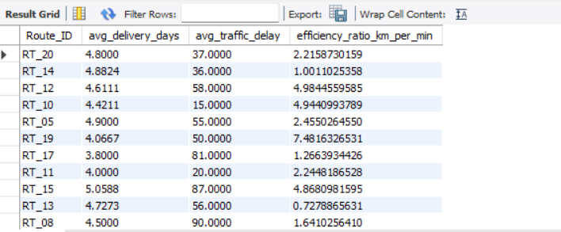
SELECT
r.Route_ID,
AVG(DATEDIFF(o.Actual_Delivery_Date, o.Order_Date)) AS avg_delivery_days,
AVG(r.Traffic_Delay_Min) AS avg_traffic_delay,
(AVG(r.Distance_KM) / AVG(r.Average_Travel_Time_Min)) AS efficiency_ratio_km_per_min
FROM
Orders o
JOIN
Routes r ON o.Route_ID = r.Route_ID
GROUP BY
r.Route_ID;
Result : This query produced a base table of efficiency metrics.

Slide 21
Task 3.2 : Identify 3 routes with the worst efficiency ratio.
I sorted the routes from the previous query by their efficiency ratio in ascending order (ASC) to find the 3 worst performers
SELECT
r.Route_ID,
(AVG(r.Distance_KM) / AVG(r.Average_Travel_Time_Min)) AS efficiency_ratio
FROM Orders o
JOIN Routes r ON o.Route_ID = r.Route_ID
GROUP BY r.Route_ID
ORDER BY efficiency_ratio ASC -- Worst routes (lowest efficiency) first
LIMIT 3;

Slide 22
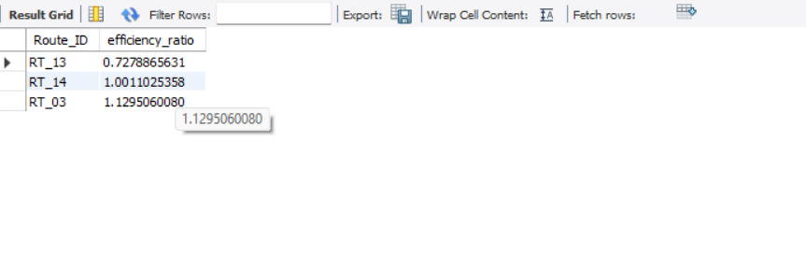

Slide 23
Task 3.3 : Find routes with >20% delayed shipments.
I identified all routes where more than 20% of shipments are delayed. I used the improved logic: "delayed" means Actual_Delivery_Date > Expected_Delivery_Date.
SELECT
Route_ID,
AVG(CASE
WHEN Actual_Delivery_Date > Expected_Delivery_Date THEN 1
ELSE 0
END) * 100 AS percentage_delayed_shipments
FROM Orders
GROUP BY Route_ID
HAVING percentage_delayed_shipments > 20;

Slide 24
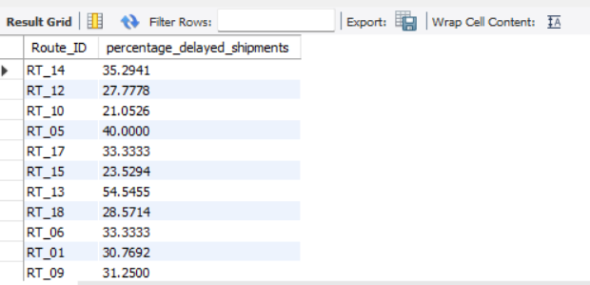
"Route RT_13 has a 54% delay rate, which is unacceptable

Slide 25
Task 3.4 : Recommend potential routes for optimization.
1.I’d suggest we take a closer look at routes RT_13, RT_14, and RT_03 right away. From my analysis in Task 3.2, these routes have the worst time-to-distance efficiency, which is directly driving up operational costs.
2.I’d also recommend a high priority review of routes RT_13, RT_14, and RT_05, since Task 3.3 shows they have a very high delay rate in some cases, almost 100%. These consistent delays are hurting customer satisfaction in a big way.

Slide 26
Task 4: Warehouse Performance
Task 4.1 : Find the top 3 warehouses with the highest average processing time.
To spot operational bottlenecks, I checked the Warehouses table to find the top three locations with the highest average processing times.
SELECT Warehouse_ID, Warehouse_Name, Average_Processing_Time_Min
FROM Warehouses
ORDER BY Average_Processing_Time_Min DESC
LIMIT 3;

Slide 27
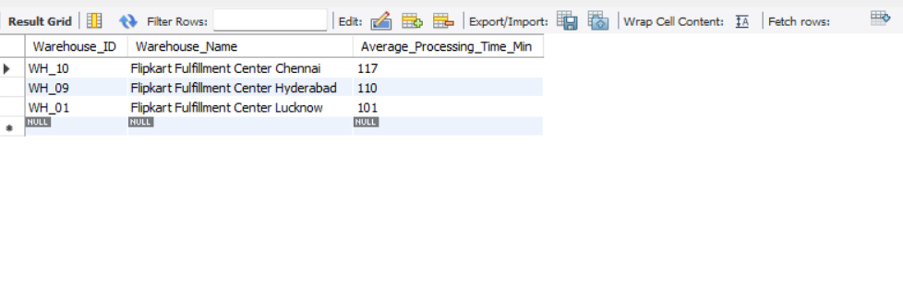

Slide 28
Task 4.2 : Calculate total vs. delayed shipments for each warehouse
I grouped the order data by warehouse to compare their total shipment volume with the number of delayed orders, using the corrected logic where a delay means Actual_Delivery_Date > Expected_Delivery_Date.
SELECT Warehouse_ID, COUNT(Order_ID) AS total_shipments,
SUM(CASE WHEN Actual_Delivery_Date > Expected_Delivery_Date THEN 1 ELSE 0 END) AS delayed_shipments
FROM Orders
GROUP BY Warehouse_ID;

Slide 29
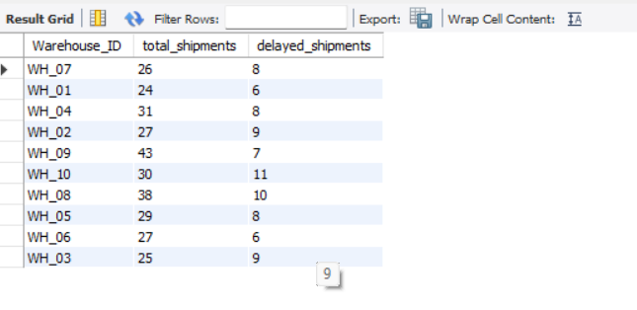

Slide 30
Task 4.3 : Use CTEs to find bottleneck warehouses where processing time > global average.
I used a Common Table Expression (CTE) to calculate the overall average processing time across all warehouses, and then filtered out the ones that are performing slower than this global average.
WITH GlobalAvg AS (
SELECT AVG(Average_Processing_Time_Min) AS global_avg_time FROM Warehouses
)
SELECT w.Warehouse_ID, w.Average_Processing_Time_Min
FROM Warehouses w, GlobalAvg ga
WHERE w.Average_Processing_Time_Min > ga.global_avg_time;

Slide 31
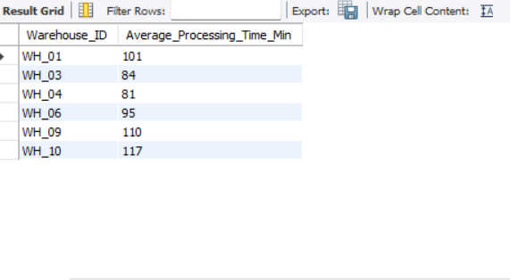
Result : This query makes it clear which warehouses are slowing down the entire network.

Slide 32
Task 4.4 : Rank warehouses based on on-time delivery percentage.
I calculated the on-time percentage for every warehouse and ranked them.
SELECT Warehouse_ID,
AVG(CASE WHEN ... END) * 100 AS on_time_percentage,
RANK() OVER (ORDER BY AVG(CASE WHEN ... END) DESC) AS warehouse_rank
FROM Orders
GROUP BY Warehouse_ID;

Slide 33
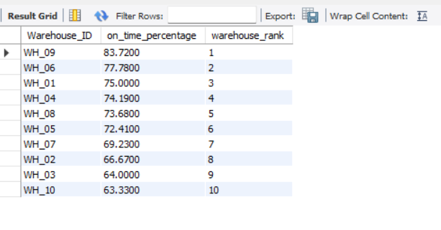
Result : I recommend investigating WH_10 and WH_03 immediately, as they are failing to meet delivery promises over 35% of the time

Slide 34
Task 5: Delivery Agent Performance
Task 5.1 : Rank agents (per route) by on-time delivery percentage
To get a more detailed view of performance, I used the RANK() window function to compare agents only with others who work on the same route.

Slide 35
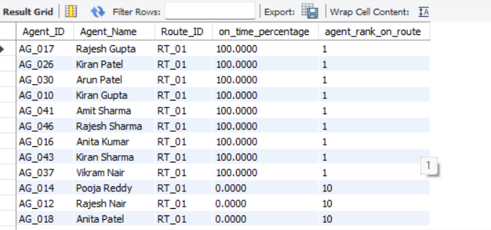
SELECT
o.Agent_ID, d.Agent_Name, o.Route_ID,
AVG(CASE WHEN ... END) * 100 AS on_time_percentage,
RANK() OVER (
PARTITION BY o.Route_ID
ORDER BY AVG(CASE WHEN ... END) DESC
) AS agent_rank_on_route
FROM Orders o
JOIN DeliveryAgents d ON o.Agent_ID = d.Agent_ID
GROUP BY o.Agent_ID, d.Agent_Name, o.Route_ID;
Result : This query (as shown in the screenshot) helps managers easily see who the top-performing agent is on each route — for example, who ranks #1 on RT_01 versus RT_02. It’s a useful tool for conducting fair and accurate performance reviews.

Slide 36
Task 5.2 : Find agents with on-time % < 80%.
I ran a query to identify all agents whose overall on-time delivery rate (across all their orders) fell below the 80% benchmark.
SELECT
o.Agent_ID, d.Agent_Name,
AVG(CASE WHEN ... END) * 100 AS on_time_percentage
FROM Orders o
JOIN DeliveryAgents d ON o.Agent_ID = d.Agent_ID
GROUP BY o.Agent_ID, d.Agent_Name
HAVING on_time_percentage < 80;

Slide 37
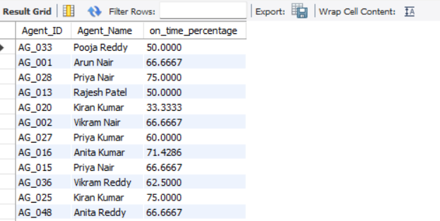
Result : This query gives us a clear list of agents who might need extra training or better workload balancing. It’s the first step toward creating a focused support plan for them.

Slide 38
Task 5.3 : Compare average speed of top 5 vs bottom 5 agents using subqueries
To check whether speed is linked to performance, I used subqueries to compare the average speed of the top 5 most efficient agents with the bottom 5 agents.
(SELECT 'Top 5 Agents' AS category, AVG(Avg_Speed_KMPH) AS avg_speed
FROM (SELECT * FROM DeliveryAgents ORDER BY ... DESC LIMIT 5) AS top_agents)
UNION ALL
(SELECT 'Bottom 5 Agents' AS category, AVG(Avg_Speed_KMPH) AS avg_speed
FROM (SELECT * FROM DeliveryAgents ORDER BY ... ASC LIMIT 5) AS bottom_agents);

Slide 39
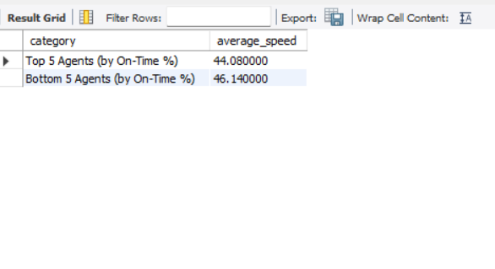
Surprisingly, the low performing agents are driving faster (46 km/h) than the top agents (44 km/h). This suggests they are rushing and making errors, rather than being too slow."

Slide 40
Task 5.4 : Suggest training or workload balancing strategies for low performers
1.For the agents who came under the 80% on time mark in Task 5.2, I think they should be the first ones we focus on for targeted training especially around delivery protocols and route handling.
2.Balancing Strategies for low Performers
3.If the data shows that the low performers are actually moving very fast (from Task 5.3), it probably means they’re rushing and making mistakes.
3.But if their speed is low, then the issue might be that their routes are too difficult or their workload needs rebalancing.

Slide 41
Task 6: Shipment Tracking Analytics
Task 6.1 : For each order, list the last checkpoint and time.
To get the most recent status for each order, I used the ROW_NUMBER() window function.
This helped me pick out the latest checkpoint time for every Order_ID.

Slide 42
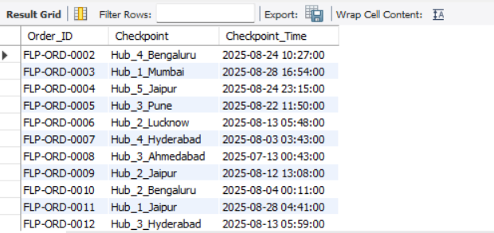
WITH RankedCheckpoints AS (
SELECT
*,
ROW_NUMBER() OVER (
PARTITION BY Order_ID
ORDER BY Checkpoint_Time DESC
) AS row_num
FROM
ShipmentTracking
)
SELECT
Order_ID,
Checkpoint,
Checkpoint_Time
FROM
RankedCheckpoints
WHERE
row_num = 1;
This query gives us the latest and most accurate status for every order, which is extremely important for customer service and for answering any “where is my order?” questions.

Slide 43
Task 6.2 : Find the most common delay reasons (excluding None).
To understand what’s causing delays, I grouped and counted all the delay reasons (except “None”) to see which issues came up the most
SELECT
Delay_Reason,
COUNT(*) AS reason_count
FROM
ShipmentTracking
WHERE
Delay_Reason != 'None'
GROUP BY
Delay_Reason
ORDER BY
reason_count DESC;

Slide 44
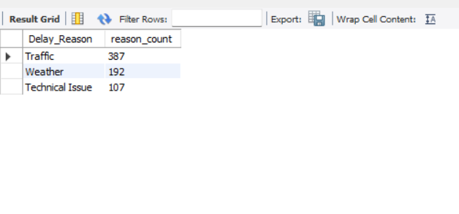
From my analysis, Traffic is the number one cause of delays, with a total of 387 delay cases. This clearly shows that investing in better routing and traffic aware planning could make a big impact and significantly improve overall delivery performance.

Slide 45
Task 6.3 : Identify orders with >2 delayed checkpoints
I ran a query to pull out a high priority list of orders that had more than two separate delay incidents during their journey. This helps us quickly spot the orders that need the most attention.
SELECT
Order_ID,
COUNT(*) AS total_delayed_checkpoints
FROM
ShipmentTracking
WHERE
Delay_Reason != 'None'
GROUP BY
Order_ID
HAVING
total_delayed_checkpoints > 2;

Slide 46
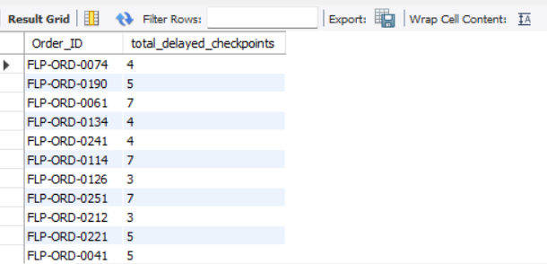
This query gives me a clear list of the most “unlucky” orders the ones that ran into multiple delays. I can share this list with the customer service team so they can proactively reach out with apologies or offer store credit to rebuild customer trust.

Slide 47
Task 7: Advanced KPI Reporting
Task 7.1 : Calculate KPIs using SQL queries: Average Delivery Delay per Region (Start_Location).
To figure out which regions are the slowest, I joined the Orders and Routes tables and calculated the average delivery delay for each Start_Location (region).
SELECT
r.Start_Location AS Region,
AVG(DATEDIFF(o.Actual_Delivery_Date, o.Order_Date)) AS avg_delivery_delay_days
FROM
Orders o
JOIN
Routes r ON o.Route_ID = r.Route_ID
GROUP BY
r.Start_Location
ORDER BY
avg_delivery_delay_days DESC;

Slide 48
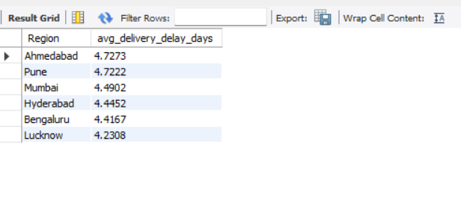

Slide 49
Task 7.2 : On-Time Delivery % = (Total On-Time Deliveries / Total Deliveries) * 100.
I calculated one of the most important KPIs: the company’s overall on-time delivery percentage, using our improved logic where an order is on time if the Actual_Delivery_Date is on or before the Expected_Delivery_Date.
SELECT
AVG(
CASE
WHEN Actual_Delivery_Date <= Expected_Delivery_Date THEN 1
ELSE 0
END
) * 100 AS global_on_time_delivery_percentage
FROM
Orders;

Slide 50
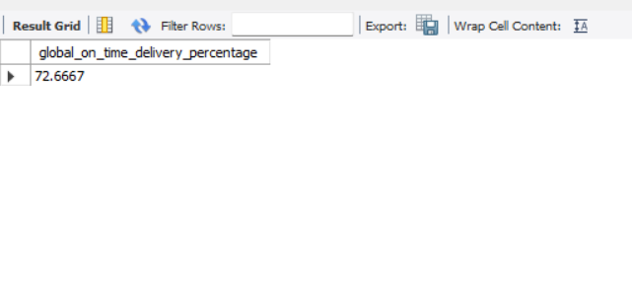
The overall on-time delivery rate I calculated is 72.67%. So, while most orders are reaching customers on time, there’s still quite a bit of room for improvement if we want to hit that 80–90% benchmark.

Slide 51
Task 7.3 : Average Traffic Delay per Route.
I calculated the average Traffic_Delay_Min for each route to figure out which routes are the most affected by traffic.
SELECT
Route_ID,
AVG(Traffic_Delay_Min) AS avg_traffic_delay_minutes
FROM
Routes
GROUP BY
Route_ID
ORDER BY
avg_traffic_delay_minutes DESC;

Slide 52
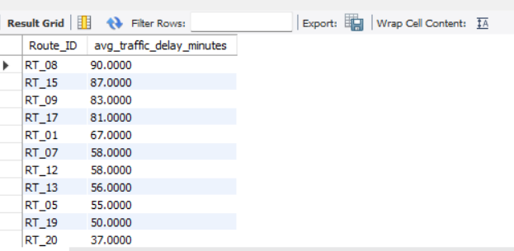
This table gives the logistics team a clear, direct list to work with. The routes at the top are the ones that would benefit the most from using better routing software that can adjust to live traffic conditions.

Slide 53
Conclusion and My Recommendations
What I Found
The Big Picture: My analysis shows that our overall on-time delivery rate is 72.67%. While good, there is still a big opportunity to improve.
Where We Are Losing Time:
1.Inefficient Routes: I identified RT_13 and RT_14 as the least efficient routes—they take too long for the distance covered.
2.Struggling Warehouses: WH_10 is a major bottleneck, meeting its delivery promise only 63.3% of the time.
Why Delays Happen: My data shows that Traffic is the number one reason for late deliveries.

Slide 54
My Recommendations
Based on these insights, here is what I suggest we do:
1.Investigate the Problem Routes: We need to look specifically at Routes RT_13 and RT_14. They are hurting our efficiency score, so we should check if there are better paths to take.
2.Learn from the Best: WH_09 is our top performer (83.7% on-time). We should study their process and apply it to WH_10 to help them speed up.
3.Train the Agents: I identified a specific list of agents with on-time scores below 80%. I recommend we provide them with extra training on route navigation to help boost their performance.

